Slide 1
Record your sources
Sources are the mainstay of genealogy and must be recorded.
Information such as a birth, marriage, death of an ancestor need to be recorded with
any documents and where you found that information

Slide 2
If you don’t record the source of your information there is a high probability that you will lose all or part of the information, or you won’t be able to find it again. You will then waste time repeating what you have previously done.
Importantly it should also say what you failed to find.

Slide 3
Research Logs help you see what you have done and where to go next. If you have a break of several months it then helps you to carry on where you left off.
You can make a research log on paper, on a searchable note taking app like Evernote or even Word or Excel

Slide 4
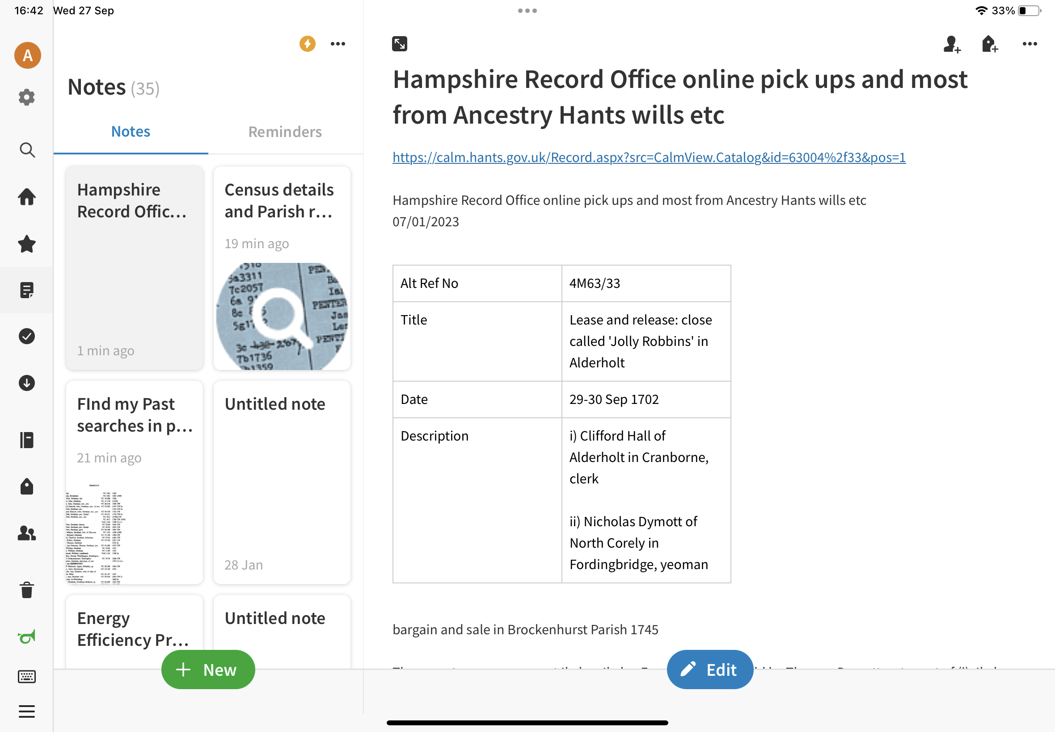

Slide 5
What’s needed on the Research Log:
1. Date and place of research ie today’s date at top of page. New records come on to the internet so you need to know when and where the research was done a while back.
2. purpose of the research - what do you want to find ?

Slide 6
Create source citations:
Book - title, author page and catalogue no if possible
Document - Catalogue no. And title if in a repository
website - name the website/route and copy the URL onto your Research Log if electronic/digital

Slide 7
Details
You need the details you are looking for
Thoughts of where to go next
Unconnected information for future use
Scope of research in years
Limitations to what you could find ?
Note strategies or questions - one or more children moved - why - job, another family member, one that stayed - look after parent ? How far did they move ? - map

Slide 8
Can’t find data:
Note if you can’t find anything - nil/none
Specify what none is for - ‘no surname found ‘ etc
If left blank you haven’t done it !
Conflicting data - say so.

Slide 9
Keywords help to find the info on the log again and a system can search more easily.
Give the person a nickname even - Thomas of Ibsley, Frederick Alan the bricklayer
Or have a numbering system. It doesn’t have to be complicated - just give the next person the next number - the numbers don’t have to relate to one another.

Slide 10
Maps :
Look at a map of the area - is it near a boundary ? Look on the other side of the boundary and note dates of boundary changes, nearby towns and villages
12mile walk for Ag Labs
Rivers/coast for transport - underground/train/tram/bus routes
Note down wider features - what could they see from where they were ?

Slide 11
Additional ideas :
To organise source sheets:
1 file per surname
Start with a pedigree chart
Each section has 1 ancestor organised chronologically.
URL digital file with links to named and numbered people for quick checking

Slide 12
Photos : Number and date and cross reference on the research log.
Documents/certificates : number and date receipt and cross ref to research log.
Emails : electronic folder and note on research log
Recordings : cross ref to research log
And - to put information on a family history program - discuss

